Slide 1
EMIL Seminar Paper Presentation
Eric Kim
Embedded Machine Intelligence Lab (EMIL)
School for Computing and Augmented Intelligence (SCAI)
Ira A. Fulton Schools of Engineering
Arizona State University

Slide 2
Paper Details
Title: One-Year Outcomes of a Digital Twin Intervention for Type 2 Diabetes
Authors: Paramesh Shamanna, Ravi Sankar Erukulapati, Ashutosh Shukla, Lisa Shah, Bree Willis, Mohamed Thajudeen, Rajiv Kovil, Rahul Baxi, Mohsin Wali, Suresh Damodharan & Shashank Joshi

Slide 3
Introduction
Digital Twin concept used to monitor and guide glucose
Used a CGM, Fitness Tracker and Application
Interventions based on nutrition, but kept track of physical activity, sleep and stress
1853 participants over 1 year
No clarification on ML models were used (just Digital Twin)
Strongly correlated with my current project

Slide 4
Background
Mainly focused on T2D
Saw an opportunity to assess the effectiveness of a digital twin
Assessment Targets
Glycemic Control (through HbA1c)
Medication Reduction
Weight Improvement
Metabolic Health Improvement

Slide 5
Methods
CGM (Abbott FreeStyle Libre)
Fitness Tracking (Fitbit Charge 2)
Smart Scale (Powermax BCA-130)
Digital Twin App (WBDT; Whole Body Digital Twin)
Age 18 - 80, 1 year commitment
3 Phases, 90 days of restricted to specific foods, 90 days of reintroduction of restricted foods, 185 days of normal food with AI guidance

Slide 6
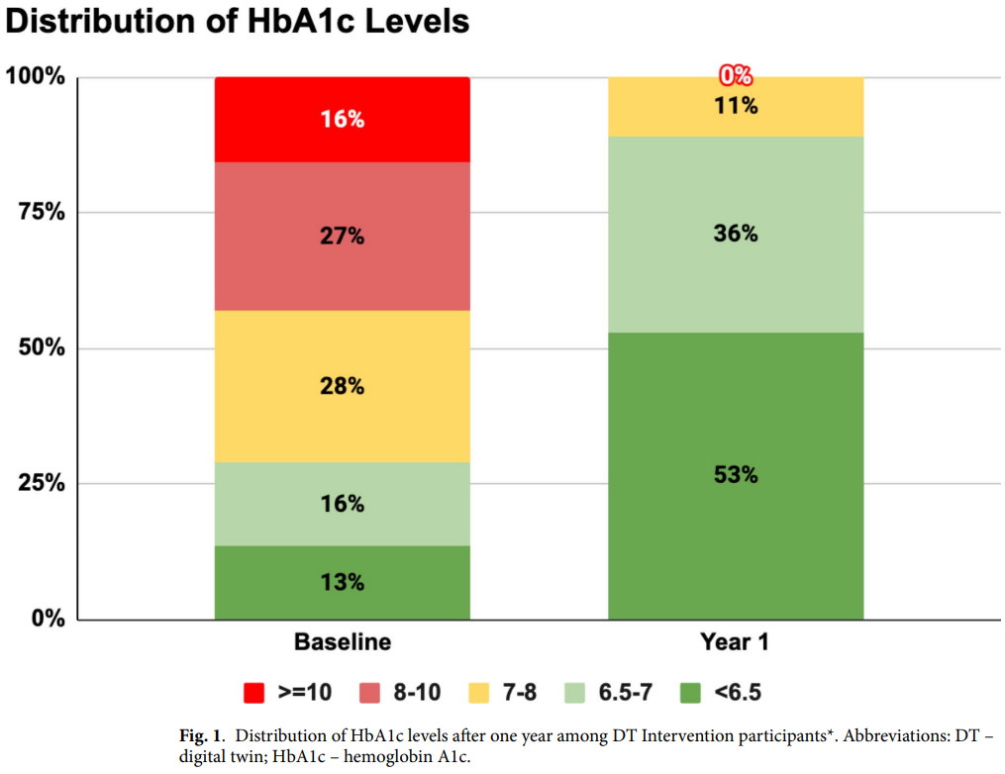
Results
HbA1c: Reflects avg glucose over past 2-3 month
Average of 1.8% decrease per participant (on the level of taking medication)
83% of participants fell below the threshold for type 2 diabetes
Major improvement by the end of the year
1% HbA1c == 21% less death, 37% less microvascular complication

Slide 7
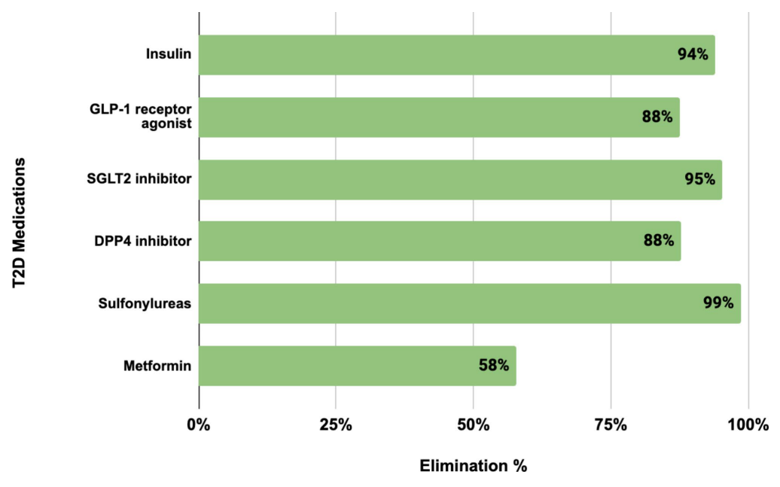
Results pt. 2
Graph shows percentage of medication that was discontinued by the participants by the end of the trials
Even in worst case, Metformin, at least 58% stopped using it
Importance: The fact that at least 58% of participants stopped taking medication entirely and replaced it with healthy eating is amazing
EX. Participants lost about 10lbs on average

Slide 8
Conclusion
Study demonstrates that a digital twin intervention leads to meaningful improvements in managing T2D.
General weight loss (10lbs avg)
Reduction/Elimination of diabetes medication
1.8% avg HbA1c reduction
Real-world intervention with scalability and engagement potential
Strong foundation for digital twins as future of health care

Slide 9
Relevance
This trial shows that digital twin can be used effectively to design interventions. AI-READI has most data to design one.
Focus was on nutrition, but stress, sleep, physical activity were all tracked to produce an effective guidance on nutrition
Results of just targeting nutrition showed major improvements over a year
My focus will be on adjusting stress/sleep/physical activity to control glucose levels

Slide 10
Reference
Shamanna, P., Erukulapati, R.S., Shukla, A. et al. One-year outcomes of a digital twin intervention for type 2 diabetes: a retrospective real-world study. Sci Rep 14, 25478 (2024). https://doi.org/10.1038/s41598-024-76584-7

